Slide 1
AWS (EC2|CloudFormation) and PowerShell Desired State Configuration
Ravikanth Chaganti
@Ravikanth
Microsoft MVP (Windows PowerShell & Microsoft Azure)

Slide 2
AGENDA
PowerShell DSC configuration delivery methods and AWS EC2
Why CloudFormation?
CloudFormation and DSC - Know How’s
Demo Scripts: https://github.com/rchaganti/Presentations/tree/master/psconfAsia2016/CFN_DSC-22Oct16

Slide 3
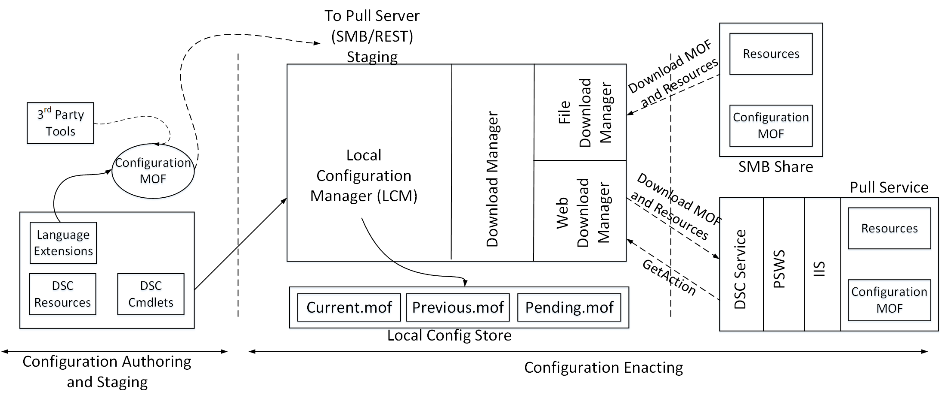
PowerShell DSC - Delivering Configuration

Slide 4
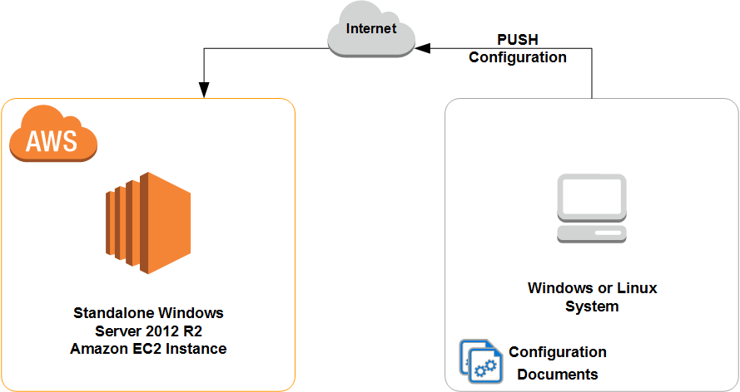
Demo – Configuration via Push
Requires WinRM configuration
HTTP (5985) or
HTTPS (5986)
Requires relevant firewall rules inside EC2 instance
Requires local administrator or equivalent credentials

Slide 5
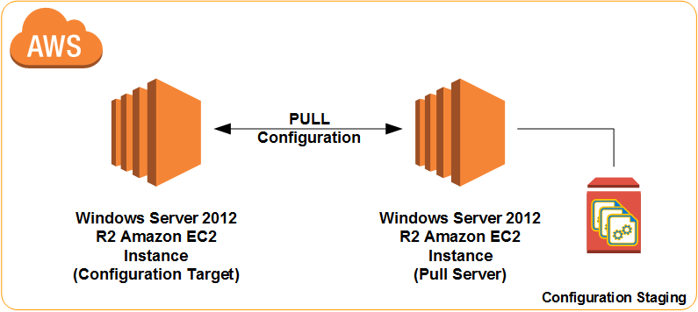
Demo – Pull Configuration via Pull Service on EC2
Requires an additional EC2 Windows instance
Requires security group configuration to allow the pull server web services access
Requires AWS credentials
Access and Shared keys

Slide 6
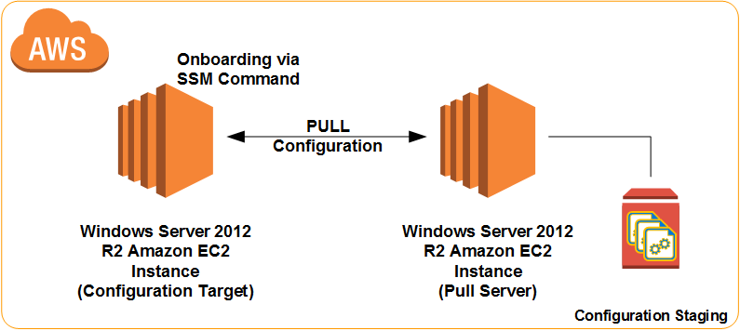
Demo – Pull Configuration via Pull Service on EC2 and onboarding via SSM Command
Requires an additional EC2 Windows instance
Requires security group configuration to allow the pull server web services access
Requires AWS credentials
Access and Shared keys
Requires meta-configuration stored in a blob

Slide 7
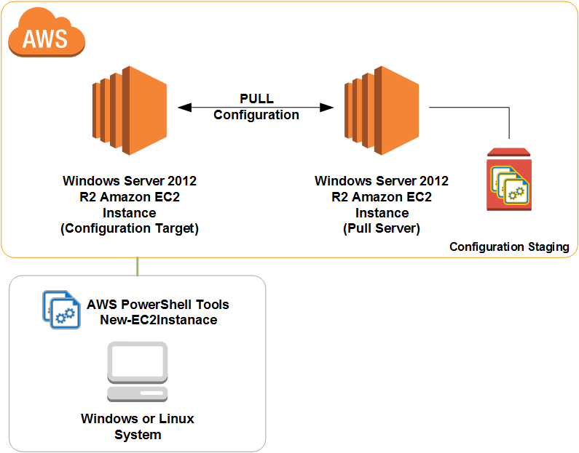
Demo – Bootstrapping new EC2 instance via Pull Service on EC2
Requires an additional EC2 Windows instance
Requires security group configuration to allow the pull server web services access
Requires AWS credentials
Access and Shared keys
Requires meta-configuration stored in a blob
Requires AWS PowerShell tools

Slide 8
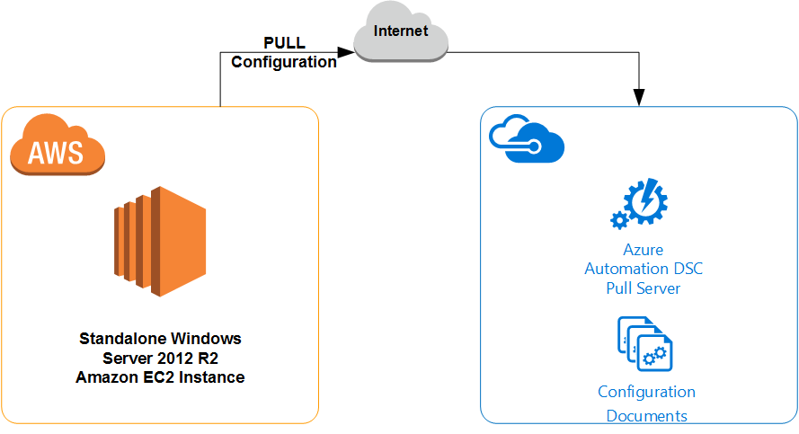
Demo – Configuration via AA DSC Pull Service
Requires Azure subscription
Requires connectivity to Azure Automation
Internet or
VPN
Requires AWS credentials
Access and Shared keys

Slide 9
Why CloudFormation?
Typical enterprise application deployments are multi-tier
Each tier may have multiple instances
Dependencies exist between tiers
Individual instance deployment is not scalable
Not DevOps friendly
Must treat an entire application service deployment as a single entity
CloudFormation enables this definition via a declarative and JSON or YAML based template language

Slide 10
CloudFormation – Template Syntax
JSON
YAML
{
"AWSTemplateFormatVersion": "version date",
"Description": "JSON string",
"Metadata": {
templatemetadata
},
"Parameters": {
setofparameters
},
"Mappings": {
setofmappings
},
"Conditions": {
setofconditions
},
"Resources": {
setofresources
},
"Outputs": {
setofoutputs
}
}
---
AWSTemplateFormatVersion: "version date"
Description:
String
Metadata:
template metadata
Parameters:
set of parameters
Mappings:
set of mappings
Conditions:
set of conditions
Resources:
set of resources
Outputs:
set of outputs

Slide 11
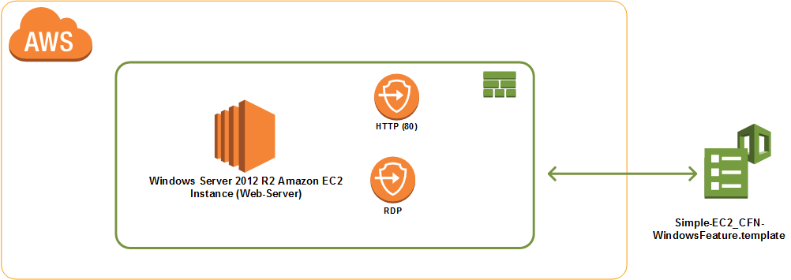
Demo – First CFN Template
Requires a keypair name
Requires security group configuration to allow RDP and web service access
Deployment via
Console
PowerShell Tools

Slide 12
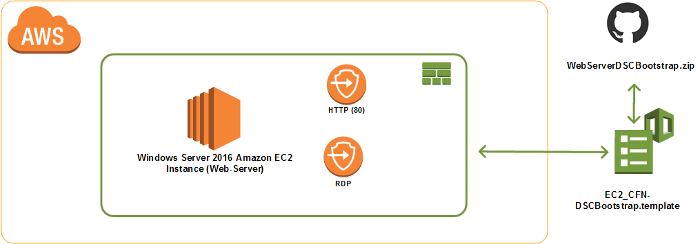
Demo – DSC Configuration via CFN Template
Requires a keypair name
Requires security group configuration to allow RDP and web service access
Requires DSC configuration stored in a place accessible to CFN
Deployment via
Console
PowerShell Tools

Slide 13
Summary
Several ways to onboard EC2 instances
Understand CFN helper scripts when using CloudFormation
xCloud services are certainly helpful

